Slide 1
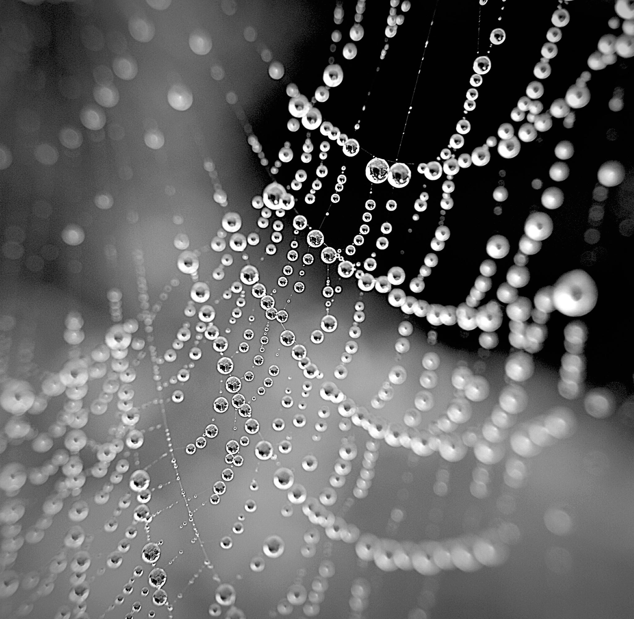
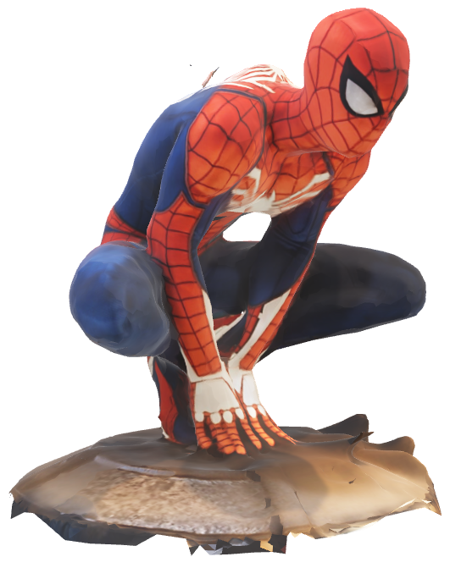
Spider Web Optimization through Genetic Algorithms
Nigel Woodhouse

Slide 2
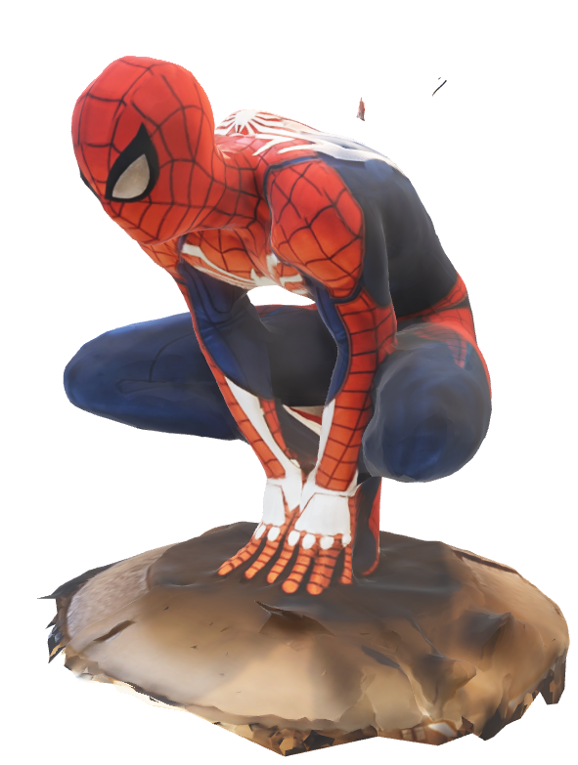
Overview
Goal
Background
Methodology
Test
Future Plans
Purpose
[1][2]

Slide 3
Goal

Slide 4
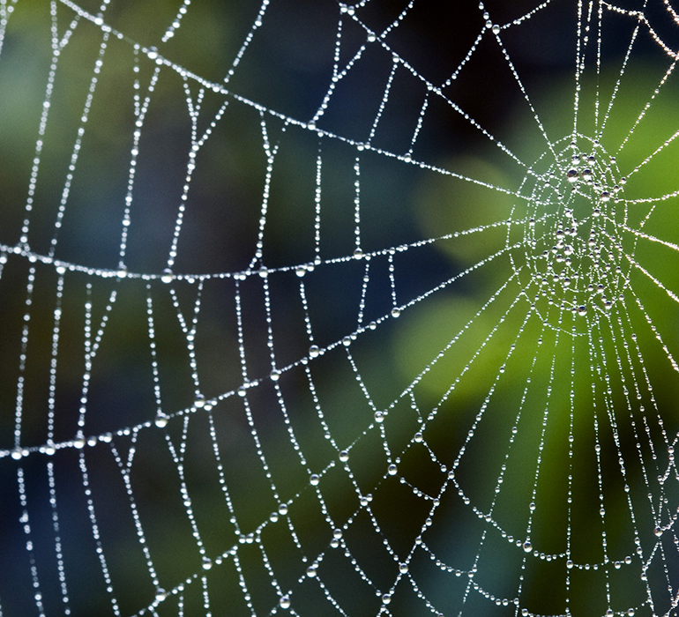
Goal
To utilize a genetic algorithm to optimize the design of a spider web
[3]

Slide 5
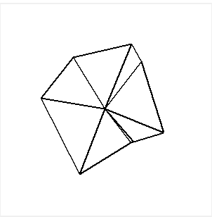
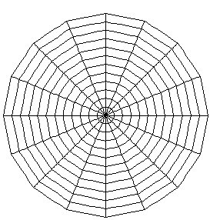
Goal
Darwin’s idea: Simple beginnings
Replicate nature
[4]

Slide 6
Background

Slide 7

Background
Spider Webs around for 100 million years
Richard Dawkins – Growing Up in the Universe Christmas Lecture (1991)
Peter Fuchs
Richard Dawkins – Coined the term “Meme”
[5]

Slide 8
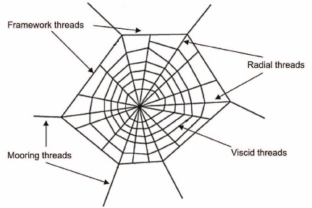
Background
Terminology
Simple Function
(Spiral threads)
[6]

Slide 9
Methodology

Slide 10
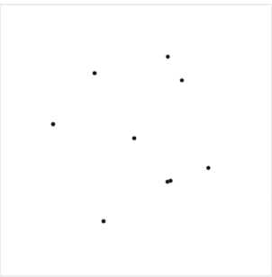
Methodology
origin
tkinter

Slide 11
Methodology

Slide 12
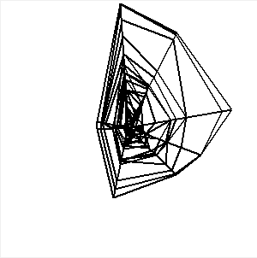
Methodology

Slide 13
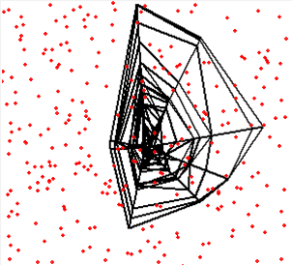
Methodology

Slide 14
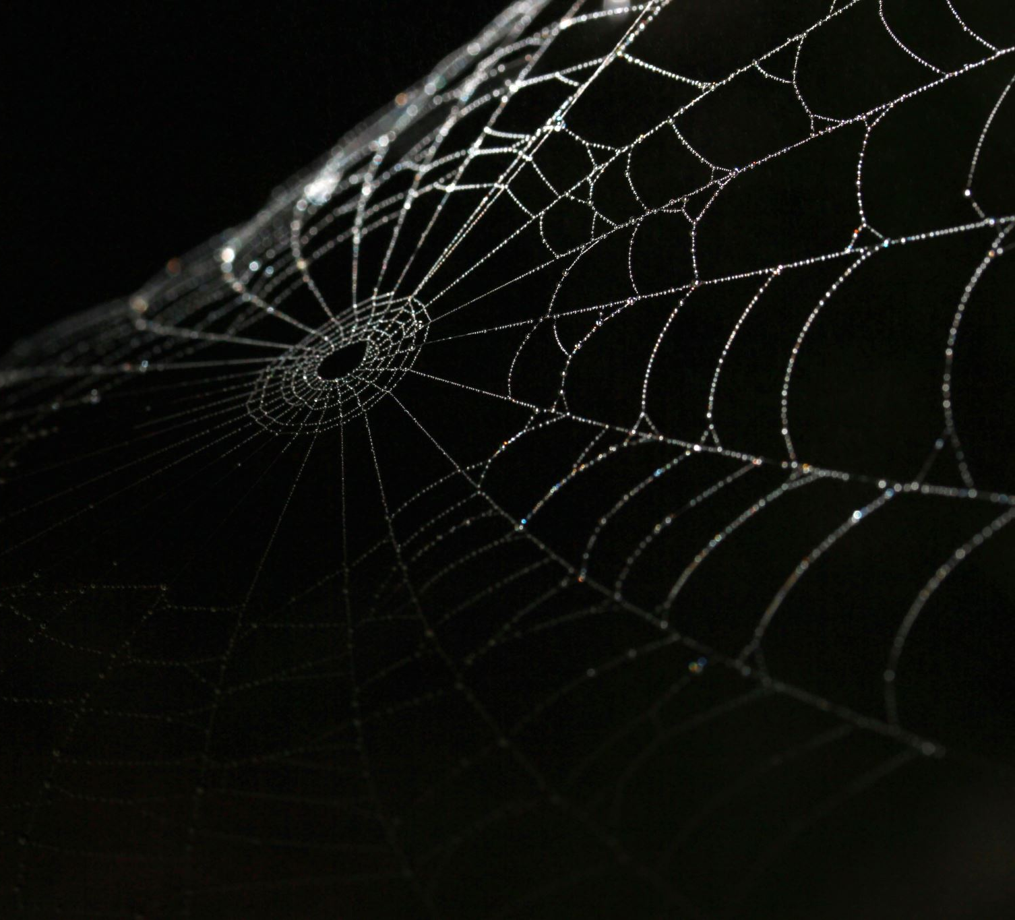
Test
Artificial Selection

Slide 15
Future Plans

Slide 16
Future Plans
Tweak
Natural Selection
Fitness – Web Cost and Insects Captured
Requires Image Processing

Slide 17
Purpose

Slide 18
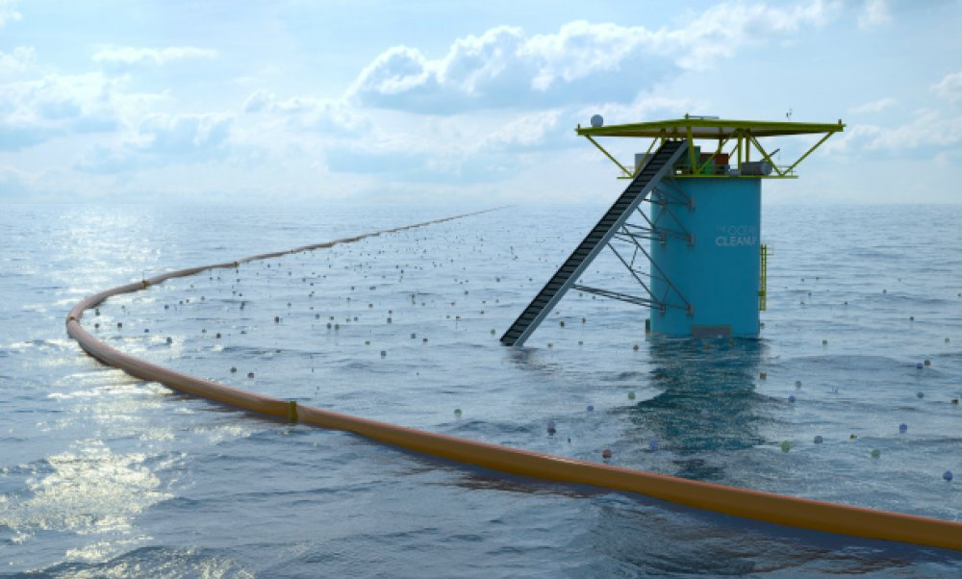
Purpose
Nets
Parachutes
[7]

Slide 19
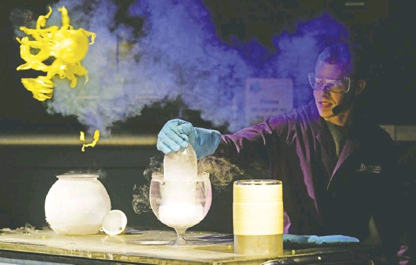
Purpose
Fun
Education
[8]

Slide 20
Sources
https://sketchfab.com/3d-models/marvels-spider-man-dbe7a777834a40a59b6b6d48b9d836f8
https://www.televisiontunes.com/Spiderman.html
https://daily.jstor.org/surprising-facts-about-spiderwebs/
https://www.researchgate.net/figure/Structure-of-a-nylon-rubber-artificial-web_fig11_270761167
https://twitter.com/richarddawkins
https://www.researchgate.net/figure/Schematic-diagram-of-a-spider-web_fig1_262813584
https://www.iamexpat.nl/expat-info/dutch-expat-news/delft-students-ocean-cleanup-crowdfunding-successful
https://www.pressreader.com/canada/edmonton-journal/20190423/281487867754580

Slide 21
